Slide 1

Building Large, Yet Maintainable, ASP.NET Core Apps
…or non-Core
Scott Sauber
Slides up at scottsauber.com
scottsauber
Notes:
Open localhost Connect to WiFi
https://www.youtube.com/watch?v=2maaprwncgw
https://gist.githubusercontent.com/clarkio/32c7dba41dfb3418eaf1/raw/a1b8ea15238efa04a019923d4c04dd9294f15171/csp-harlem-shake-test.js

Slide 2

Audience
Existing ASP.NET/ASP.NET Core Developers
Building “Large” applications
Large to me, means a combination of these:
Many Controllers and/or Views
Lots of business logic
High business impact
Frequent Change
Large != High Traffic
You may be:
Server-rendered HTML via MVC or Razor Pages
API’s only via MVC
Building backend logic
scottsauber

Slide 3
Audience Goals
“New” perspective on a few topics
You’re not going to agree on everything
Take away some ideas to evaluate in your future workflow tomorrow
scottsauber

Slide 4

Who am I?
Software Consultant at Lean TECHniques
.NET Foundation Action Groups
IADNUG co-organizer
Blog (primarily ASP.NET Core) at scottsauber.com
Background in Mortgage, Health Insurance, Ag Industry
Users from 1 – 250K
Highly Regulated
Lots of validation
Lots of changes
scottsauber

Slide 5
Agenda
Lightning Talk approach
Talk about best practices for all these *in a large app*
Folder Structure
UI Components
Code Flow
Validation
ORM’s
Dependency Injection
Unit Testing and Assertions
DevOps
Feature Toggles
Microservices
scottsauber
Notes:
I find I get most bang for my buck getting a 5 min Lightning Talk from someone on a topic, so that’s what this is.
<after talking about all these> BINGO

Slide 6
Overall theme
Improve Maintainability
Better practices
Consistency
Enjoyable to work with
Create systems that allow developers to make changes as easy, quick, and bug-free as possible, while allowing that trend to continue into the future.
“Legacy software is software you have no confidence in.”
scottsauber

Slide 7
Assumptions
I’m assuming you have a traditional LOB app without crazy volume
The answer is always “It Depends” but I’m going to throw that out the window and give some real guidance.
scottsauber

Slide 8
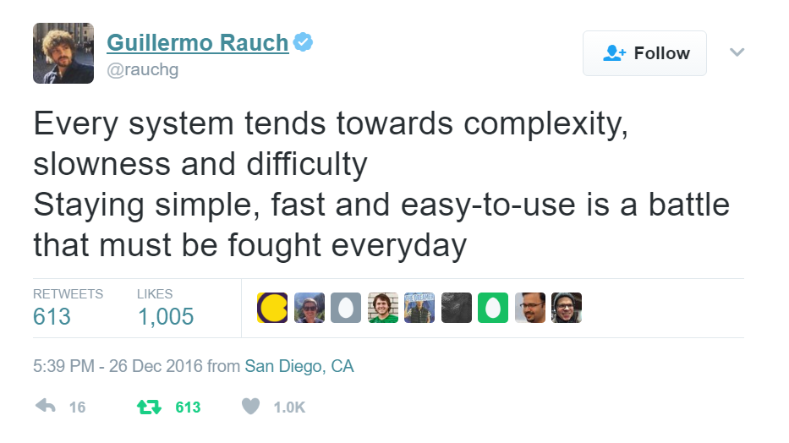

Slide 9
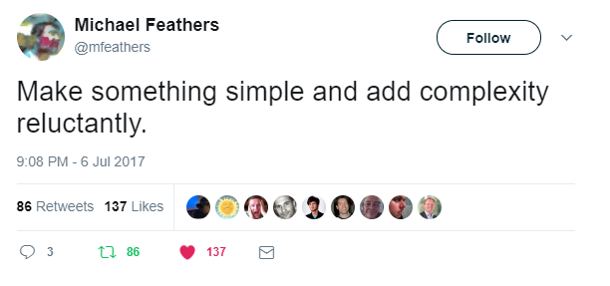

Slide 10
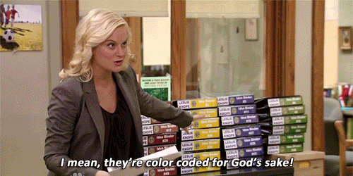
Folder Structure

Slide 11
Problem: OOB MVC Folders By Responsibility
All of these live in their own separate folders and most are required to add a new feature
Controllers
Views
Models
wwwroot/css
wwwroot/js
Adds navigation friction
Scope of a feature is scattered
Makes it hard to add, delete or extend existing features
scottsauber

Slide 12
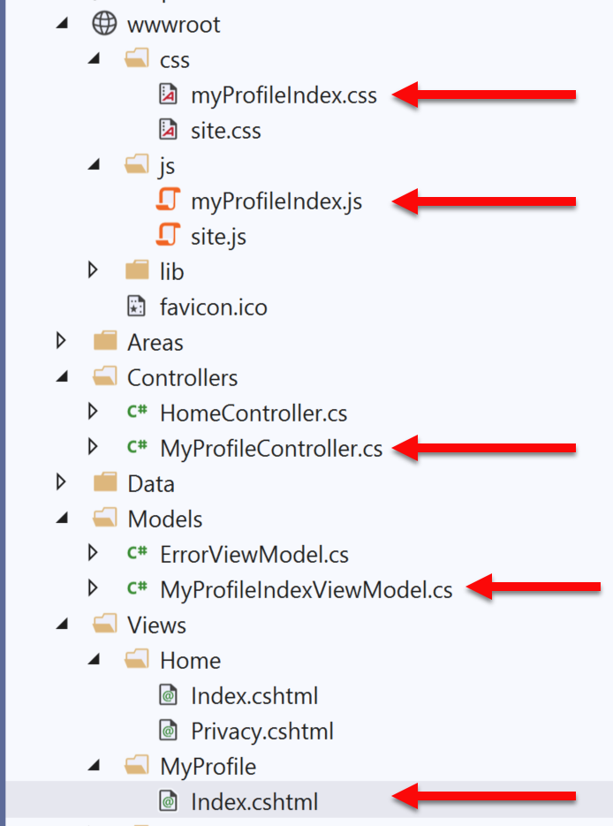
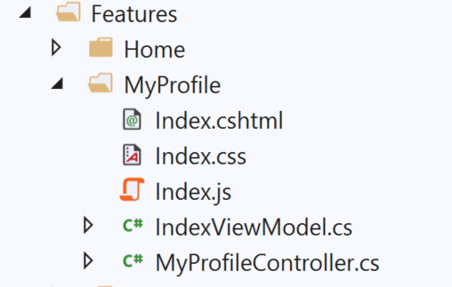
Solution: Use Feature Folders
Grouping by Feature, not by Responsibility, results in easier maintenance
Related things remain together (High Cohesion)
MVC out of the box:
Feature Folders:
Notes:
Some even put tests in their feature folders

Slide 13
Feature Folder Extra Resources
How to do this in ASP.NET Core
My blog post
Steve Smith’s Blog on Feature Folders vs. Areas
How to do this in ASP.NET 4.x
Tim Thomas’ blog post
Also used in React, Angular, etc.
John Papa
scottsauber

Slide 14
Questions on Feature Folders?

Slide 15
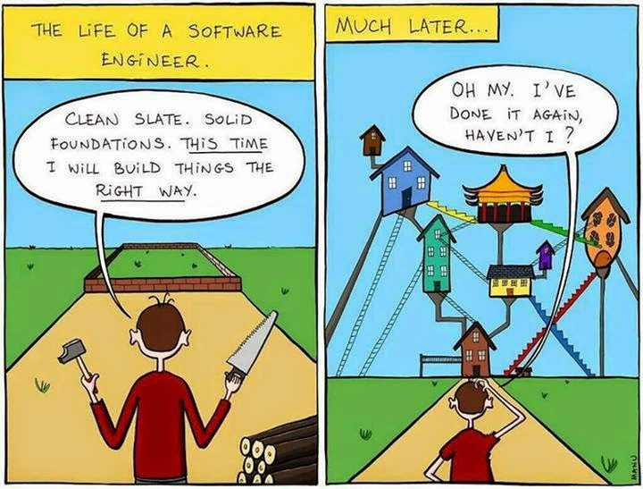
UI Composition

Slide 16
Make as many UI Components as you can
Benefits
SRP for the UI
Easier to reason about
Reusability
Eliminates div soup
Component architecture is here to stay
React, Vue, Angular, AngularJS 1.5+, Knockout 3.2+, Blazor
Partials
View Components
Blazor Components
Child Actions (in ASP.NET 4)
scottsauber

Slide 17
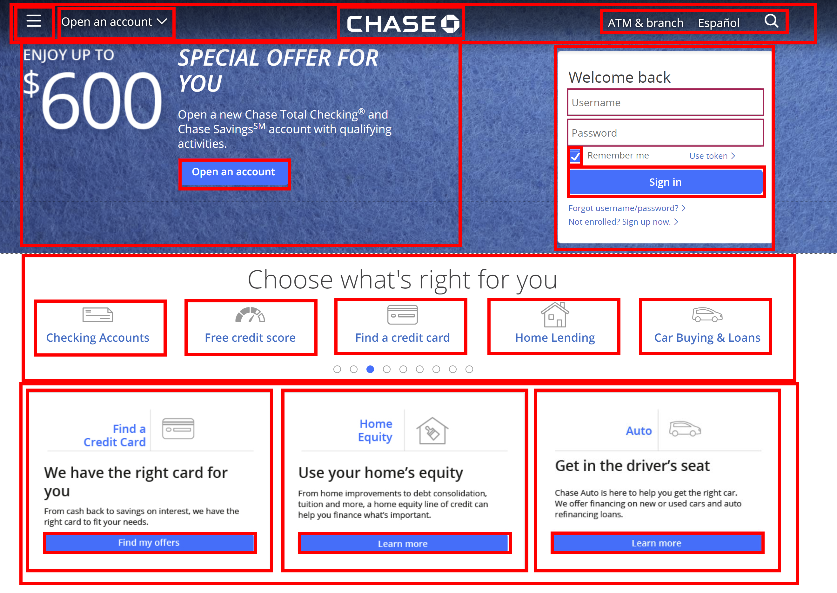

Slide 18
Questions on Components?

Slide 19
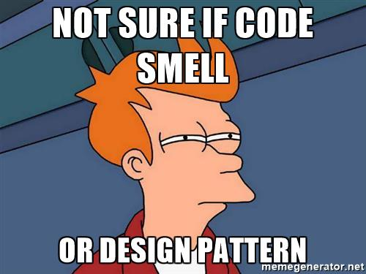
Code Flow/Smells

Slide 20
Structuring a method
Happy Path always at the bottom of the method
Don’t want to scan for “what happens when all goes well” and find it in the middle of a method
Use return’s instead of nested if => else
scottsauber

Slide 21
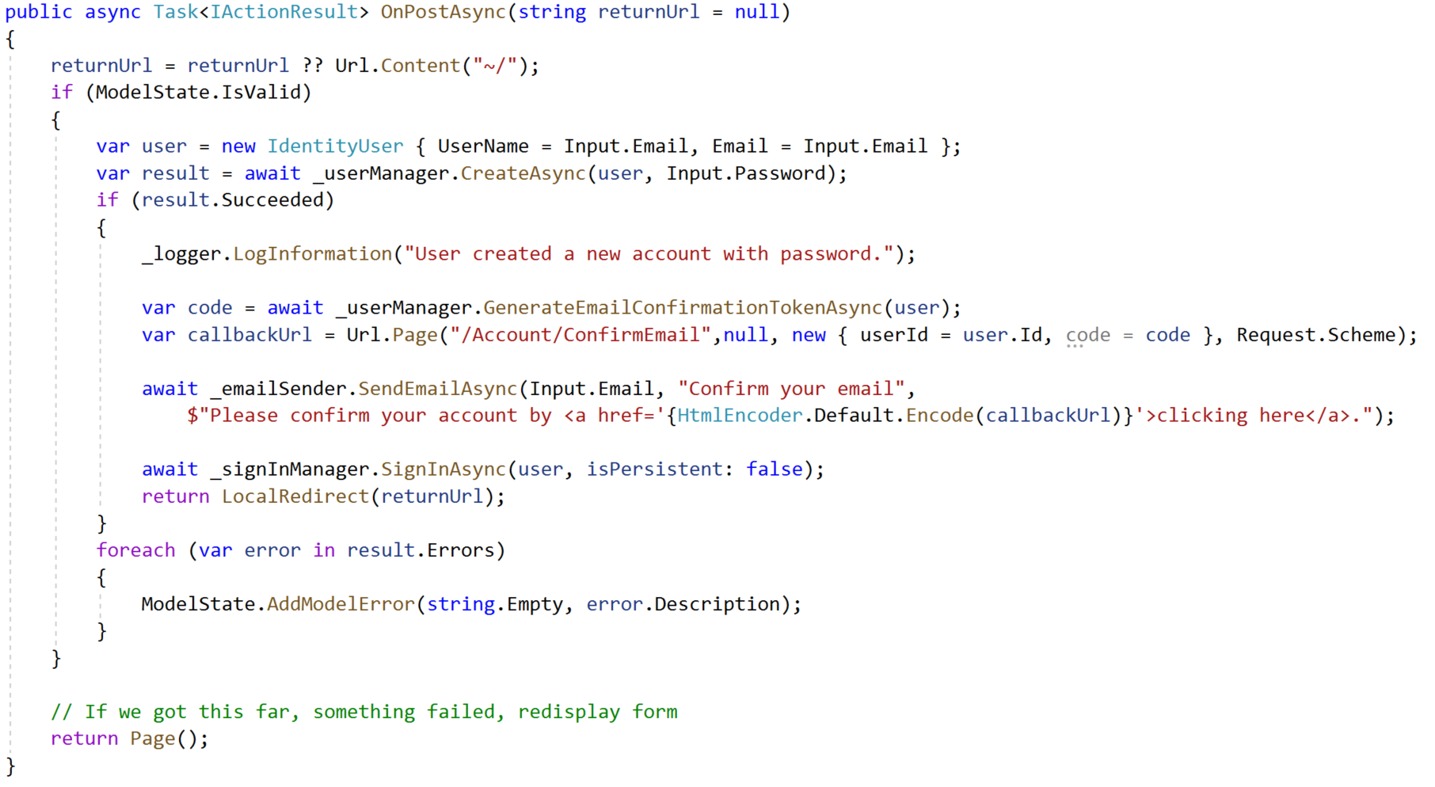
Razor Pages Template Code:

Slide 22
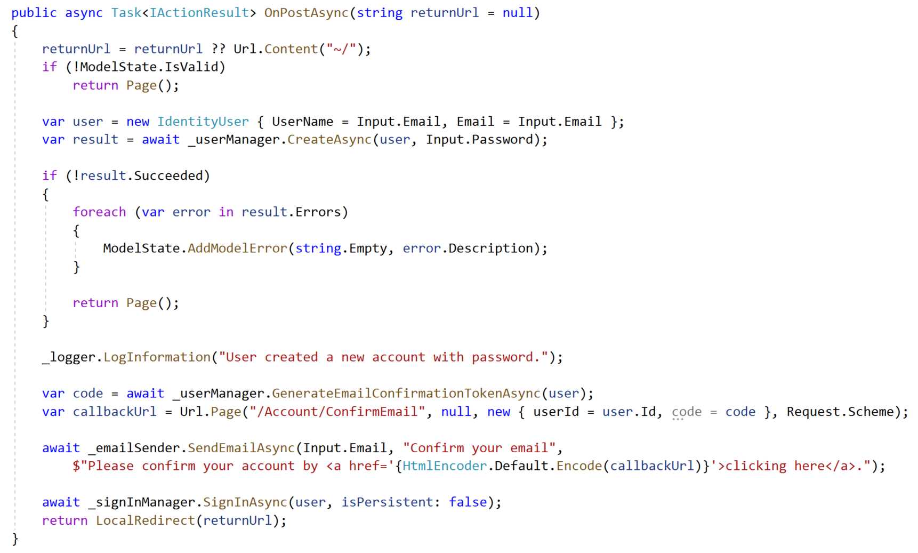
Refactored with Happy Path At The Bottom:

Slide 23
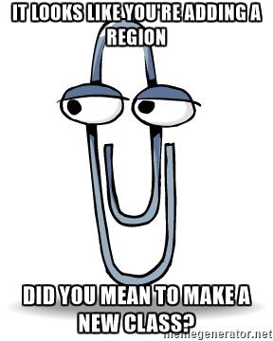
Code smells
Not hard and fast rules, just my “warning light”
Methods > 30 lines
Classes > 200 lines
Regions
You probably should’ve added a new class or method instead

Slide 24
The Indentation Proclamation
The more indented your code is, the harder it is to follow
Nested if’s, nested loops, etc.
…I made this up
scottsauber

Slide 25
Questions on Code Flow/Smells?

Slide 26

Validation

Slide 27
Validation – What’s wrong with OOB Options
Data Annotations
Only work well for simple scenarios
Hard to make custom ones
Hard to unit test
Separate annotations for each property
Can get “tall”
SRP violated
Model + Validation combined into one class
Writing own Custom Validation classes
Lose client-side hooks Data Annotations provides
scottsauber
Notes:
Data Annotations don’t scale for large application

Slide 28

Solution: Use FluentValidation
Fluent interface
Business rules are easy to maintain and read
Easy to show a stakeholder
Easy to test
Integrates with ModelState.IsValid
Same Client-Side validation as Data Annotations
20.2M downloads
https://github.com/JeremySkinner/FluentValidation
scottsauber

Slide 29
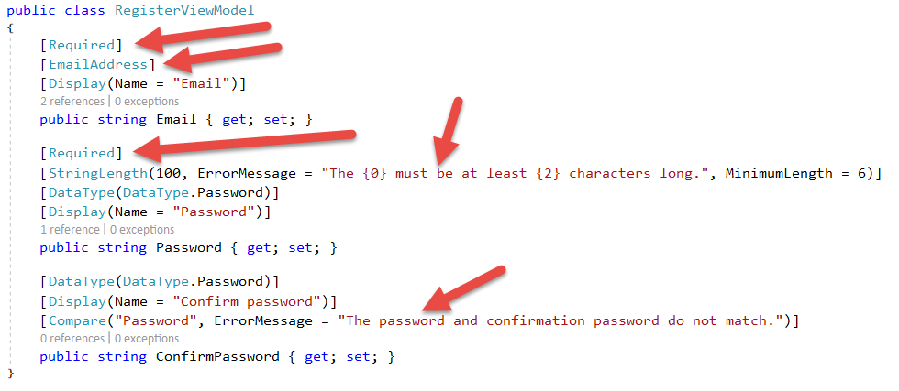
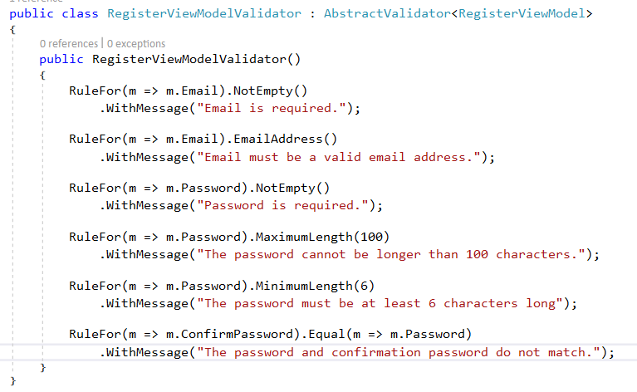
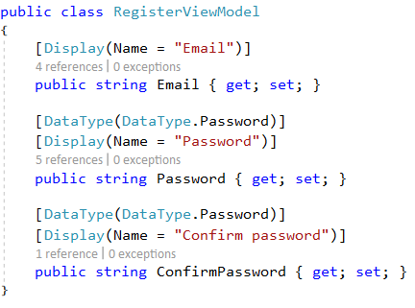
Template Code:
Refactored with Fluent Validation:
Notes:
You can see MVC 5 Template, the Validation logic is mixed in with the presentation logic of the View Model itself like the Display Name or the Data Type of Password which tells MVC what kind of Textbox to make.

Slide 30
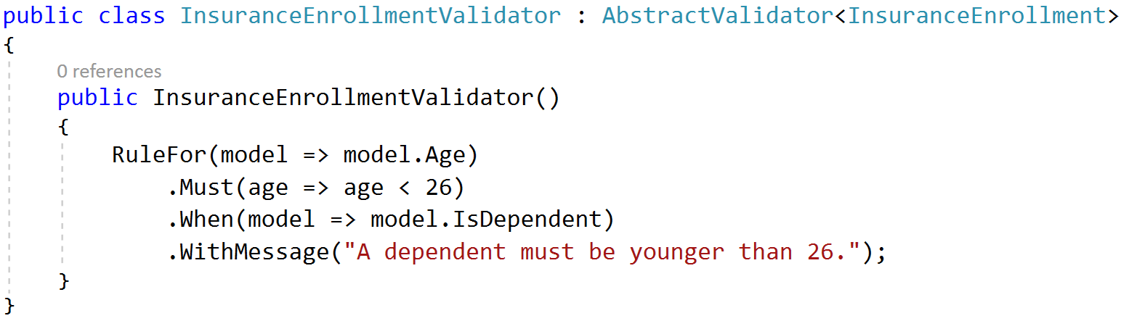
A Rule that only exists if….

Slide 31
Questions on Fluent Validation?

Slide 32

ORM’s

Slide 33

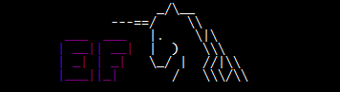
Don’t use raw ADO - Use an ORM
Entity Framework – Full ORM
Pros
Developer Productivity
Compile-time safety with LINQ Queries
Extremely quick to add new CRUD operations
Built in Unit of Work
Migration support
Cons
Less performant
Less control over the queries generated
Heavier
Dapper – Micro ORM
Pros
Performance near ADO
More control over the queries
Extremely simple to setup
Stack Overflow beta tests
Cons
SQL strings = Big column name refactorings are harder
Less features than EF
Notes:
Using an ORM will help you map to objects, which will help you make your view models

Slide 34
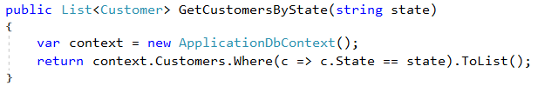
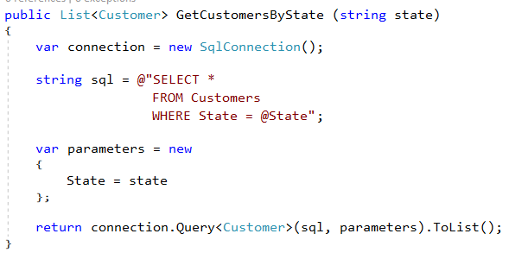
ORM usage comparison
Entity Framework:
Dapper:
Notes:
Obviously would want to inject in a SQL Connection or a DbContext here, not new up inline. But just showing you the objects both interact with. EF with DbContext and Dapper with SQL Connection.
Both manage connection life times for you. No more try/finally blocks.
Dapper more verbose and more to know about SQL, but you get better performance.
Both illustrate preventing

Slide 35
Other ORM things
Both manage connection lifetimes
Both give you SQL Injection protection
I use both depending on the job
Common for us to start with EF and supplement with Dapper
EF for Developer Productivity
Dapper for hot paths
Dapper for queries that are tough to write in LINQ
DON’T WRITE YOUR OWN ORM
scottsauber
Notes:
Using an ORM will help you map to objects, which will help you make your view models

Slide 36
Questions on ORM’s?

Slide 37

Dependency Injection

Slide 38
Dependency Injection and IoC containers
DI/IoC helps you loosely couple your “large” apps
Lets you unit test anything if done correctly
I use Microsoft.Extensions.DependencyInjection
Scrutor for auto-registration
scottsauber

Slide 39
Common DI Pitfalls
“New Is Glue”
“Static Cling”
DateTime.Now (and variants)
Instead inject in IClock or have method take in DateTime? and default to Now
HttpContext
IHttpContextAccessor in ASP.NET Core
ConfigurationManager in ASP.NET 4.x
Instead, inject a POCO Settings class
scottsauber

Slide 40
Questions on Dependency Injection?

Slide 41
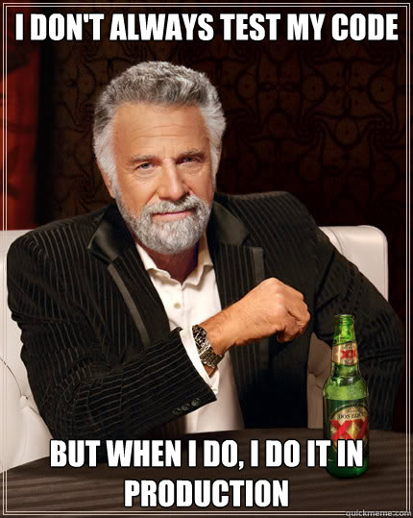
Automated Testing

Slide 42
Automated Testing with xUnit
You should be writing automated tests
Exposes holes in your architecture
Proven to be faster long-term
Make changes quickly and confidently because have a regression test suite
“Start at the back”
Use xUnit or NUnit
Just not MSTest which is wayyy more verbose and has less features
xUnit used by ASP.NET team
I used to use NUnit and switched to xUnit
NUnit more boilerplate
No [TestFixture] in xUnit
No [SetUp] method just use a constructor in xUnit
scottsauber

Slide 43
Problem: OOB Assertion Libraries Annoy Me
Assert.Equal(value, value)
Hard to remember that it’s Assert.Equal(expected, actual)
Can lead to funky looking assertion failures if you flip them
No “Because” string in xUnit’s assertions
scottsauber

Slide 44
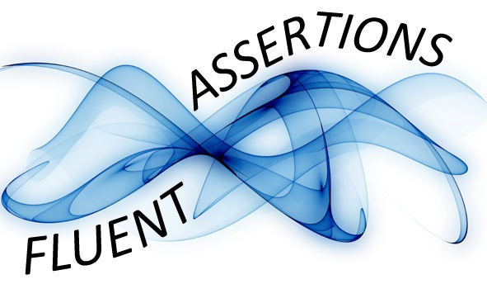
Solution: Use FluentAssertions for assertions
Adds a Should() extension method to object
result.Should().Be(0);
Easier to read than Assert.Equal(0, result);
Because string to explain why
can12YearOldDriveResult.Should().Be(false, “because you must be 16 years old to drive.”)
28.7M downloads
scottsauber

Slide 45
Questions on Automated Testing?

Slide 46
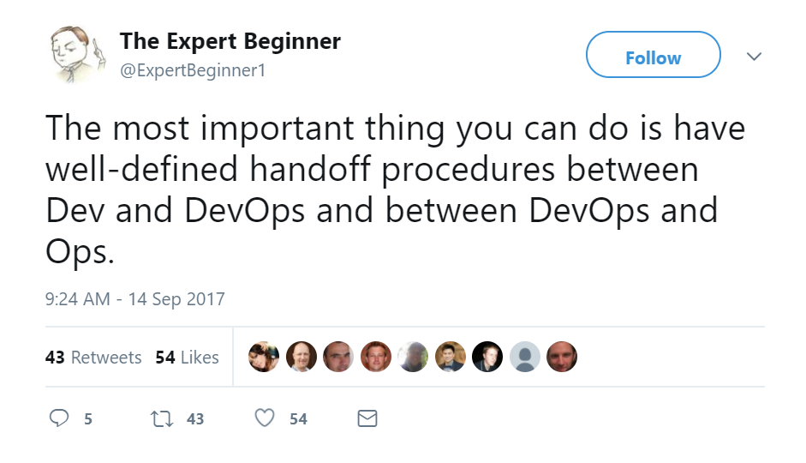
DevOps

Slide 47
What is DevOps
“DevOps is the union of people, process, and products to enable continuous delivery of value to our end users.”
- Donovan Brown

Slide 48

DevOps Pipeline

Slide 49
Continuous Integration and Delivery
Continuous Integration Server
Automated builds running on an independent build server
Automatically running automated tests
Creates an output
Continuous Delivery
Takes the output from the build server and deploys it
Go through different environments
Automated configuration of VM, IIS, folder permissions, Azure WebApp, etc.
These two together will be transformational for you and your company
scottsauber

Slide 50
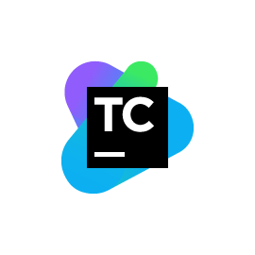
Continuous Integration with TeamCity
Free for up to 100 build configs
No support or $1999/year with support
NuGet Restores
MSBuild
Don’t need to install VS on your build server
Run automated tests
Produces an output
Zips up and sends to Octopus Deploy
scottsauber

Slide 51

Continuous Delivery with Octopus Deploy
Lets you promote your package through different environments
Controls all appsettings/web.config scoped to each environment
Auto-creates IIS Site and App Pool for you
Deploys and rollbacks are click of a button
Lets you run any scripts you want to as part of your deployment
Easy to install and easy to use
Professional – 25 deployment targets $2300/yr
Full Audit Trail
Who/What/When changed
My single favorite piece of software – ever
scottsauber

Slide 52
TeamCity + Octopus Deploy enables...
Consistency
Machine repeats the same steps over and over again
Consistency promotes Confidence
Passes build
Passes automated tests
Configuration is correct
Let’s deploy it to Prod!
Confidence enables agility
Mid-day publishes are no big deal
For a single app, our record is 24 publishes to Prod in 1 day with 2 developers
scottsauber

Slide 53

Azure DevOps
Can handle Source Control, Builds, Deploys
Octopus is still more full featured
But AzDO gives you 1 product
Also can do work item tracking
scottsauber

Slide 54
Questions on DevOps?

Slide 55

Feature Toggles

Slide 56
Feature Toggles
No long lived branches
No environment branches
Commit to master instead!
Behind an if statement
Reduce merge conflicts
Simplest way: config files
appsettings.{Environment}.json
Commit to cleaning up after it’s live
Clearly separate out your Feature Toggles to make it obvious what Feature Toggles exist
Have a FeatureToggles class or section in your config file
scottsauber

Slide 57
Questions on Feature Toggles?

Slide 58
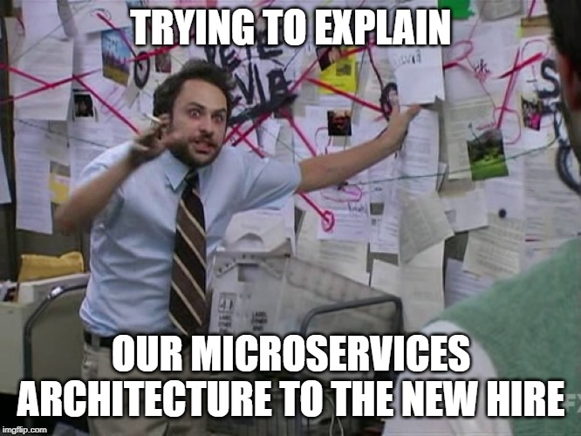
Microservices

Slide 59
<Something about Microservices />
When I say Microservices I mean some out of process call of some sort (web service, queue, etc.)
Microservices add operational complexity
Health Checks
Is it running? Are the dependencies ok?
Load Balancing
Service Discovery (via Consul or something simple like config files with primary/backup)
Perf is worse
Microservices add development complexity
HTTP call (most likely) instead of a method call
If calling from C#, likely want a client library wrapper around HttpClient sending JSON
Dev environment needs multiple projects running
Cross-cutting things (users, logging, common packages, versions, etc.)
scottsauber

Slide 60
<Something about Microservices />
Benefits
Iterate on microservices separate from other app (SRP)
Reuse
Scale independently
Easy to reason about in small chunks
You are not Google/Facebook/Netflix/Amazon
Use where it makes sense:
Needs scale
High CPU usage
Isolate an annoying dependency
Separate teams
Hard costs is a priority over engineering costs (i.e. Lambda, Azure Functions)

Slide 61
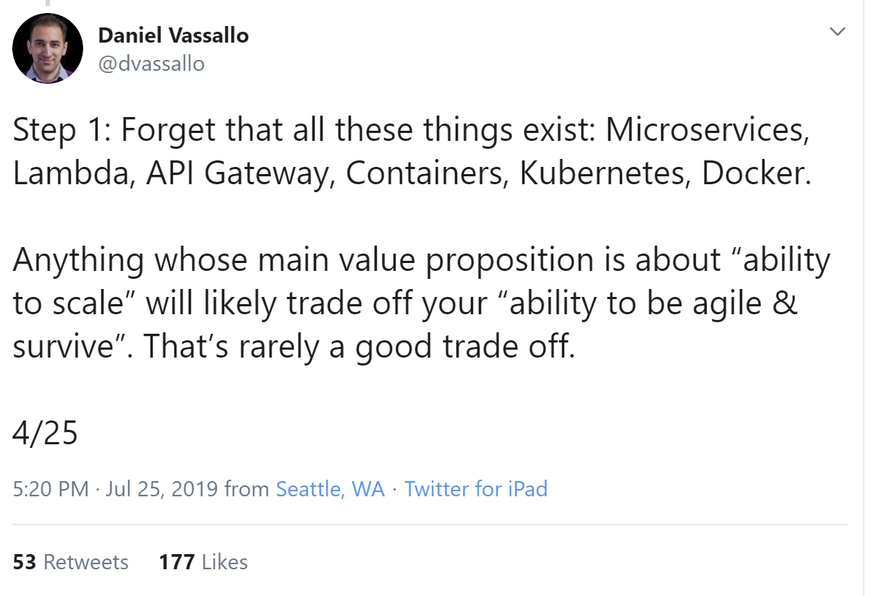
Notes:
When I say microservices, I mean a web service or a queue… basically an out of process call

Slide 63
Questions on Microservices?

Slide 64
Real benefits of these practices
1 web app went from deploying to Prod 20x a year to deploying to Prod over 500x a year.
Faster delivery of value to users.
scottsauber

Slide 65
Summary
Feature Folders > MVC Folders
SRP for UI with Components
Happy Path at the Bottom of a Method
FluentValidation over Data Annotations/Custom
Use an ORM
Avoid new, Statics, HttpContext, ConfigurationManager for testing
Automate your Build and Release pipeline
Use Feature Toggles over environment branches
Resist Microservices until there’s a good reason not to
scottsauber

Slide 66
Closing
Hope you got at least one idea out of this.
You likely don’t agree with everything I just said.
Remember – point is to deliver value to your end users as quickly and reliably as possible and allowing that trend to continue in the future.
Don’t get caught up in what library you’re using
If you use NUnit instead of xUnit and have no reason to switch – who cares?
Important thing is you’re doing automated testing.
scottsauber

Slide 67
Questions?
Feel free to reach out on Twitter (@scottsauber) if you think of a question later
Slides posted on my blog (scottsauber.com) and I’ll tweet them out
Don’t forget to fill out evals, please
scottsauber

Slide 68
Thanks!

